Slide 1
BLOCKCHAIN & DECENTRALIZED FINANCE
Recap…

Slide 2
Blockchain & DeFi – Day 2
Recap
We discussed Bitcoin, the first truly distributed ledger.
We understood how the decentralization works in Bitcoin and why it is no longer centrally controlled?
We covered the structure, including Coin, Block, Transaction, UTXOs and Proof of Work protocol.
We briefly discussed Bitcoin from economic and environmental perspective.
We investigated a Bitcoin Transaction on its blockchain explorer.

Slide 3
Blockchain & DeFi – Day 2
Agenda
Ethereum and its emergence.
Bitcoin’s limitations and Ethereum’s contribution.
Proof of Stake, the Frankenstein slayer.
Why PoS wins?
Ethereum Nodes. You can host one as well. Should IBA?
Building a Decentralized Web app through vibe coding.
Workshop feedback collection Dapp

Slide 4

BLOCKCHAIN & DECENTRALIZED FINANCE
Ethereum

Slide 5

Blockchain & DeFi – Day 3
Emergence
One must still have chaos in oneself to be able to give birth to a dancing star [Friedrich Nietzsche]
In 2013, Vitalik published a groundbreaking whitepaper introducing Ethereum.
Bitcoin solves one giant problem – decentralization of money.
Ethereum harnessed the full potential of blockchains.
Notes:
Nietzsche spoke of chaos giving birth to stars; Vitalik Buterin proved it — from the uncertainty of what Bitcoin could not do, he created what the blockchain could become.
Vitalik questioned Bitcoin’s limits and imagined a system where the blockchain itself could think

Slide 6
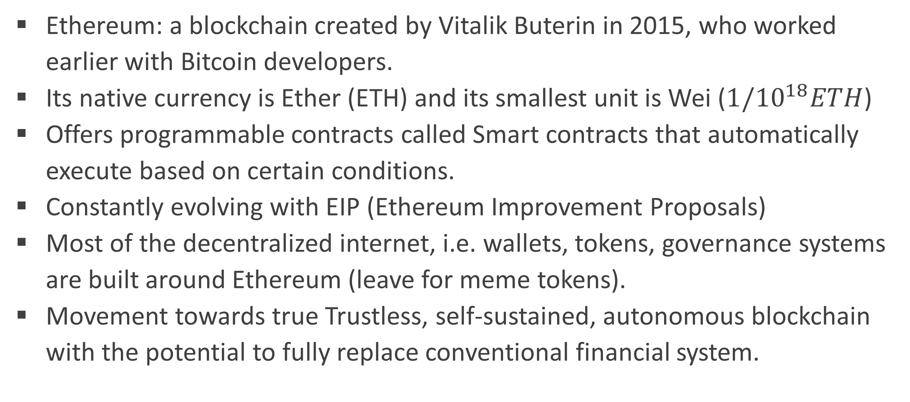
Blockchain & DeFi – Day 3
Emergence
Ethereum: a blockchain created by Vitalik Buterin in 2015, who worked earlier with Bitcoin developers.
Its native currency is Ether (ETH) and its smallest unit is Wei ($1/{10}^{18}ETH$)
Offers programmable contracts called Smart contracts that automatically execute based on certain conditions.
Constantly evolving with EIP (Ethereum Improvement Proposals)
Most of the decentralized internet, i.e. wallets, tokens, governance systems are built around Ethereum (leave for meme tokens).
Movement towards true Trustless, self-sustained, autonomous blockchain with the potential to fully replace conventional financial system.

Slide 7
Blockchain & DeFi – Day 3
Bitcoin’s limitations and Ethereum’s contribution.
Proof of work is a good approach, until it isn’t.
Bitcoin maintains “state” of coins, not accounts. There isn’t even an option to introduce a human-friendly identifier.
BTC is the only currency, hence the blockchain can only be a shop, not a marketplace.
The Scripts in Bitcoin can define rules about the funds… but that’s it.
Notes:
Proof of work requires immense computation for no good reason other than just solving a puzzle. Also, after 21M BTC, mining reward will be zeroed and only Tx fee rewards will remain, which will definitely be much higher then.
Namecoin, in 2010 started a decentralized name registration database which allows named identifiers and not only pseudo-random hash codes as addresses.
Bitcoin scripts are more of a function with fixed parameters, not like a class that can have its own custom data and functions.

Slide 8
Blockchain & DeFi – Day 3
Proof of Stake, the Frankenstein slayer
Proof of stake (since 2021) as consensus mechanism.
Ethers have no hard cap; they are continuously created and burned. (Gold vs Oil).
Account-centric. But the accounts can also contain data and even code.
Ethereum is common currency; then there’s Layer-2.
Smart Contracts… on a Turing-complete language.
Notes:
PoS came after The MERGE in 2022: validators lock up 32 ETH to create blocks. It uses far less energy, achieves faster finality, and supports higher scalability via sharding. BTC is 7TPS (Tx per second), ETH is 20-30TPS.
With new blocks, new Ethers are created and when transactions occur, these Ethers are burnt as Gas.
While BTC manages state of coins in transactions, ETH maintains accounts and balances inside.
Layer-2 can have custom tokens which can be currencies, DAOs, NFTs, DeFi, Identity systems, gaming economics, etc.

Slide 9
Blockchain & DeFi – Day 3
Proof of Stake, the Frankenstein slayer
Proof of Work: a consensus mechanism.
PoW: solve a complex mathematical puzzle to compute a hash that also fits the criteria enforced by Blockchain.
Proof of Stake: another consensus mechanism used by Ethereum.
PoS: still compute hashes to create blocks, but difficulty is not deliberately increased.
Validator: an Eth node which stakes 32ETH to become a validator and validates transactions and creates new blocks.

Slide 10
Blockchain & DeFi – Day 3
Proof of Stake – workflow
Thousands of nodes have submitted 32ETH or higher to become validators.
Once a node becomes validator, it is entrusted to:
  Stay online and reachable
  Do the actual hash calculation to create new blocks.
The network picks validators randomly to write new blocks (via lot).
The validator checks transactions, verifies them, computes hashes and broadcast to the network.
Other validators verify as well. If a consensus is reached, the new block is added
If other validators find signs of forgery, the network slashes the staked ETH.

Slide 11
Blockchain & DeFi – Day 3
Proof of Stake – workflow
Imagine a network with 3 validator nodes.
Ali is randomly selected in advance to form a new block.
Ali adds 3 transactions, calculates block hash and broadcasts to Omar and Fatima.
Omar and Fatima becomes validators and are rewarded for attestation.
Ali appears to be at a loss, but as more validators are added, their individual share is reduced.
Validator | Coins Staked | Share
Ali | 500 | 50%
Omar | 300 | 30%
Fatima | 200 | 20%
From | To | Amount | Gas fee
Fizza | Ahmed | 0.023 | 0.005
Imran | Huzaifa | 0.8 | 0.005
Saad | Ayesha | 1.55 | 0.01
Validator | Reward
Ali | 20% of 0.02 = 0.004
Omar, Fatima | 0.008 each

Slide 12
Blockchain & DeFi – Day 3
Why PoS Wins?
PoS does not demand useless computation.
In PoS consensus, nodes do not race with each other. The computation power does not increase chances to win.
Environmental cost is significantly lower.
The wealth itself is at stake, not computation power.
It is in the interest of Stakeholders to ensure fair play.
In some cases, validators can lend coins to each other to make up for unavoidable mistakes like network latency and hardware failure.

Slide 13
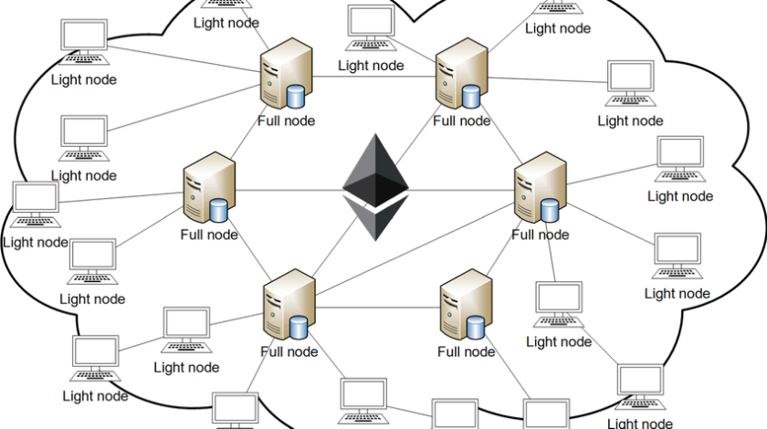
Blockchain & DeFi – Day 3
Ethereum Nodes
Full Node: stores entire blockchain from the genesis block but prunes old, unnecessary state data. (approx. 2TB)
Snapshot: optimization of full nodes that uses periodic snapshots of the blockchain state for faster syncing. (200 – 300GB)
Archive: keeps every block, every transaction, and every intermediate state since genesis block. (15TB)
Notes:
Hosting an Ethereum node doesn’t even require you to stop using your computer.
Ethereum Virtual Machine is a VM inside the Ethereum node where the native bytecode executes.

Slide 14
Blockchain & DeFi – Day 3
Ethereum Nodes
How one can host one:
  Tools like Stereum make it very easy to setup a Node.
  Go-Ethereum (Geth): an Ethereum execution client that downloads, maintains, synchronizes Ethereum blockchain and provides API to interact with it.
  Prysm: a consensus client is responsible for PoS. It runs validators, propose blocks and attest them.
Notes:
Geth is written in Go language. Nethermind (C#), Besu (Java) are some of its alternatives
Prysm’s alternatives are Lighthouse (rust) and Teku (Java)

Slide 15
Blockchain & DeFi – Day 3
Ethereum Nodes
Should IBA host its own full node?
  NO, if the objective is simply to teach Solidity or deploy a few smart contracts; public RPC providers may suffice.
  YES, if the objective is to conduct sustained blockchain research, run institutional DApps or teach blockchain infrastructure hands-on.
Hosting an Ethereum node does not require a GPU.

Slide 16
Blockchain & DeFi – Day 3
Instructions
Visit https://iba-defi-workshop-2026-feedback.netlify.app
This is a Decentralized App, deployed on Sepolia test net.
Connect with your wallet.
Submit a feedback form. You will need a small amount of SETH to submit your form.
The Smart contract address that was deployed is:
0xc260fF1A0B099F977Bb5f845Eef1c6CE4bba8288

Slide 17
Practical Exercise/Demo
Next Week…
Ethereum blockchain and its structure.
Logs and Events.
Why Ethereum is the right platform to develop a Finance ecosystem.

